Slide 1
STUDENT NAME | Logesh.S
REGISTERATION NO | 20324U09047
NMID | 112D60378140D74954B4C34DFDBD3084
DEPARTMENT | BCA
COLLEGE | DR. M. G. R. CHOCKALINGAM ARTS COLLEGE
UNIVERSITY | THIRUVALLUVAR UNIVERSITY

Slide 2
PROJECT TITLE
STUDENT DIGITAL PORTFOLIO USING FRONT END WEB DEVELOPMENT (HTML, CSS & JAVASCRIPT)

Slide 3
AGENDA
Problem Statement
Project Overview
End Users
Tools and Technologies
Portfolio design and Layout
Features and Functionality
Results and Screenshots
Conclusion
Github Link

Slide 4
PROBLEM STATEMENT
In ltoday’s digital era, students and professionals need an effective way to showcase their skills, achievements, and experiences beyond traditional resumes and paper-based portfolios. Traditional methods often fail to provide interactive, easily accessible, and visually appealing representations of an individual’s work. There is a lack of a centralized, customizable, and professional platform where individuals can present their projects, certifications, and personal accomplishments in a structured manner. This creates challenges in personal branding, career opportunities, and academic recognition.

Slide 5
PROJECT OVERVIEW
The Digital Portfolio Project aims to create an interactive and professional platform where individuals can effectively showcase their personal, academic, and professional achievements. Unlike traditional resumes, which provide limited information in static text form, this portfolio will serve as a dynamic online space that highlights skills, experiences, and accomplishments in a visually engaging and easily accessible way

Slide 6
WHO ARE THE END USERS?
Students (Academic Projects, Resumes, CV’s)
Job Seekers/ Freshers (To share the personal details to recruiters)
Freelancer (to showcase their clients)
Professionals (To Highlight the experience of work and achievements)

Slide 7
TOOLS AND TECHNIQUES
HTML - Structure (pages, sections)
CSS - Styling (colors, layouts, responsiveness)
JavaScript -> Interactivity (navigation menu, animations, form validation)
Code editor Visual Studio Code
Hosting platform GitHub for Version Controls
Web Browser -> Microsoft Edge or Google Chrome or any other related browsers

Slide 8
POTFOLIO DESIGN AND LAYOUT
Sections included:
Home/About Me Projects Skills
Certifications
Education Details Contact Responsive layout (mobile + desktop view).

Slide 9
FEATURES AND FUNCTIONALITY
Homepage / Introduction
Brief bio with name, profession, and tagline. Professional photo or avatar. Highlighted achievements or skills 2. About Me Section Personal background, career journey, and goals. Resume download option (PDF). Key strengths and values.

Slide 10
3. Projects / Work Showcase Portfolio of completed works (websites, designs, reports, apps, etc.). Each project with images, description, tools used, and outcomes. Links to live projects or GitHub/Behance/Dribbble. 4. Skills & Expertise Technical and soft skills displayed visually (progress bars, charts, badges). Categorized (e.g., programming, design, communication). 5. Education & Experience Academic qualifications with timeline. Internships, work experience, certifications.

Slide 11
RESULTS
The result of a digital portfolio is basically what you achieve or showcase after creating it. In simple terms, it is the outcome or benefits that a digital portfolio provides. For a student, the result includes:
Showcasing Skills & Projects: Talents, projects, and certifications are displayed clearly in one place.
Better Opportunities: Helps in college admissions for PG’s, internships, and job applications by presenting your profile professionally.
Easy Access: A single link for teachers, recruiters, or peers to view your work anytime.
Personal Branding: Builds a strong online presence and highlights your strengths.
Feedback & Improvement: Enables you to get comments or suggestions to grow further.

Slide 12
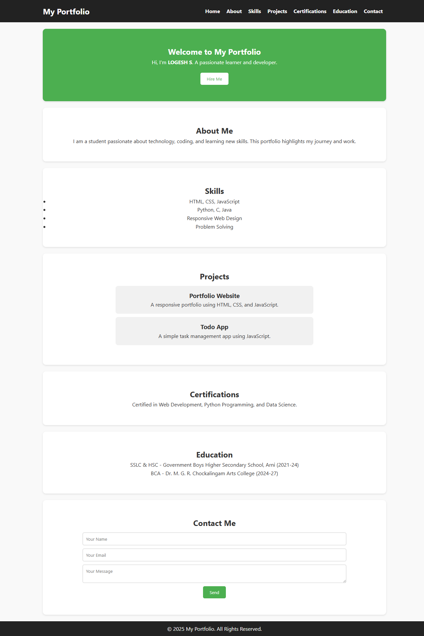
SCREENSHOT/ OUTPUT

Slide 13
CONCLUSION
A digital portfolio is a modern platform for showcasing a student’s skills, education, projects, and achievements in one place.
It helps create a strong personal brand and improves visibility for career or academic opportunities. With its interactive and professional design, it highlights growth, creativity, and technical expertise effectively.

Slide 14
PROJECT LINK
https://github.com/logesh-s-1/Digital-Portfolio.git
OUTPUT LINK
https://logesh-s-1.github.io/Digital-Portfolio/

